Slide 1
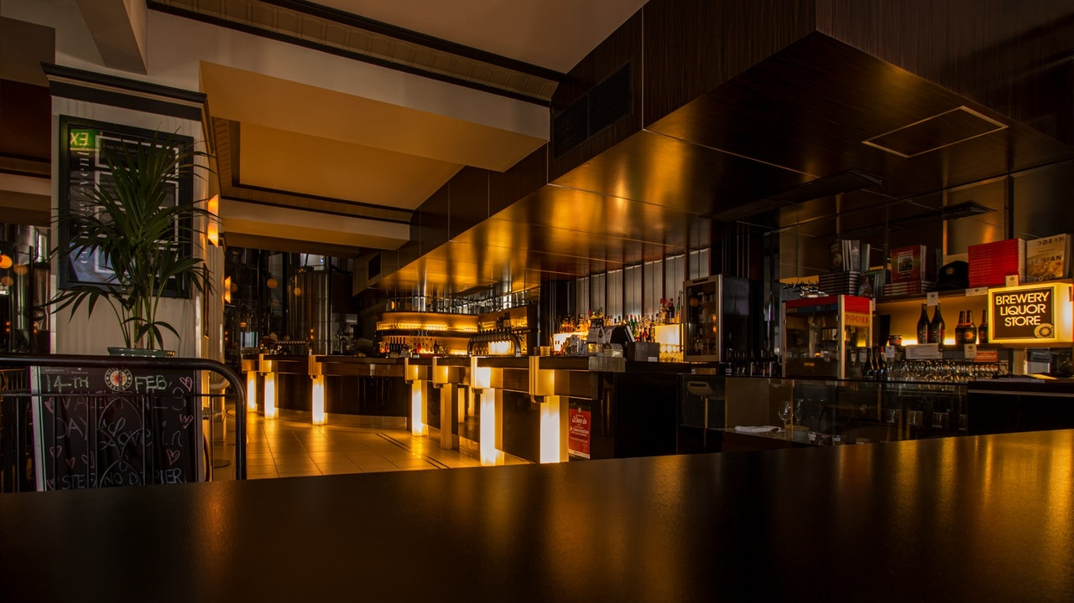

Dosa Express Restaurant
Enjoy the authentic South-Indian Taste
Final semester project for acquiring the MCA Degree from GLS University
Notes:
Links:
https://www.pexels.com/photo/alcohol-architecture-bar-beer-260922/

Slide 2


Group No:-62
Enrollment No Name
201900721010094 Patel Dipal
Project Guide:- Pooja Ajwani
Notes:
Links:
https://www.pexels.com/photo/pendant-bulb-photo-750843/

Slide 3
Online Food Order System
A simple and convenient way for customers to purchase food online, without having to go to the restaurant..
As per this system, the customer visits the restaurant’s website, browses through the various food items, combos and cuisines available there and goes ahead and selects and purchases the items he or she needs.
These items will then be delivered to the customer at his or her doorstep at the time they choose by a delivery person.
This system for online food delivery is completely safe, secure and is a very popular method that is revolutionizing the way in which the food industry operates.
Notes:
Links:
https://www.pexels.com/photo/pendant-bulb-photo-750843/

Slide 4
PROPOSED SYSTEM
Admin
User
Notes:
Links:
https://www.pexels.com/photo/pendant-bulb-photo-750843/

Slide 5
ADMIN
Login
Home Page
Menu
Select Item
View Booking
Payment Method
Log Out
Notes:
Links:
https://www.pexels.com/photo/pendant-bulb-photo-750843/

Slide 6
USER
Home page
Menu
View product
Shopping cart
Place order
Conform order
Contact as
Notes:
Links:
https://www.pexels.com/photo/pendant-bulb-photo-750843/

Slide 7
SOFTWARE REQUIREMENTS
Windows / Ubuntu / macOS
XAMPP(For creating virtual client)
IDE(For Development)
Notes:
Links:
https://www.pexels.com/photo/pendant-bulb-photo-750843/

Slide 8
MINIMUM HARDWARE REQUIREMENT
Processor - i3
Hard Disk – 5 GB
Memory – 1GB RAM
Notes:
Links:
https://www.pexels.com/photo/pendant-bulb-photo-750843/

Slide 9
FEATURES
A Mobile-Ready Version
Mobile Compatibility.
Accessible to All Users.
Fast Load Times.
Browser Consistency.
Effective Navigation.
Good Error Handling
Notes:
Links:
https://www.pexels.com/photo/pendant-bulb-photo-750843/

Slide 10
FUNCTIONILITY
A Site Map
Simple Pages with Minimal Scroll
Use of Both HTML and CSS
A Search Tool
Cross-Platform Capabilities
An Attractive Color Scheme
A Consistent Theme
Photos and Images
Notes:
Links:
https://www.pexels.com/photo/pendant-bulb-photo-750843/

Slide 11
TABLE DETAILS
Admin
Fielde | Datatype | size | constraint | Description
Adminid | Int | 10 | Primary Key | Store admin id
AdminName | Varchar | 100 | NOT_NULL | Store admin name
AdminUsername | Varchar | 100 | NOT_NULL | Store admin username
AdminPassword | Varchar | 125 | NOT_NULL | Store admin password

Slide 12
Category
Field | Datatype | size | constraint | Description
Id | int | 10 | Primary Key | Store category id
Title | Varchar | 100 | NOT_NULL | Store category title
Image_name | Varchar | 255 | NOT_NULL | Store category image_name
Featured | Varchar | 10 | NOT_NULL | Store Featured
Active | Varchar | 10 | NOT_NULL | Store Active

Slide 13
Food
Field | Datatype | Size | Constraint | Description
FoodId | int | 10 | Primary Key | Store Food Id
FoodTitle | Varchar | 150 | NOT_NULL | Store Food Title
FoodDescription | Varchar | 255 | NOT_NULL | Store Food Description
FoodPrice | Decimal | 10,2 | NOT_NULL | Store Food Price
FoodImage_name | Varchar | 255 | NOT_NULL | Store Food Image_name
FoodCategory_id | int | 10 | Foreign Key | Store Food Category_id
Featured | Varchar | 10 | NOT_NULL | Store Featured
Active | Varchar | 10 | NOT_NULL | Store Active

Slide 14
Order
Field | Datatype | Size | Constraint | Description
OrderId | int | 10 | Primary Key | Store order Id
OrderFood | Varchar | 150 | NOT_NULL | Store order food
OrderPrice | Varchar | 255 | NOT_NULL | Store order price
Orderqty | decimal | 10,2 | NOT_NULL | Store order qty
OrderTotal | Varchar | 255 | NOT_NULL | Store order total
OrderDate | int | 10 | NOT_NULL | Store order date
OrderStatus | Varchar | 10 | NOT_NULL | Store order status
Customer_name | Varchar | 10 | NOT_NULL | Store customer_name
Customer_contact | Type |  | NOT_NULL | Store customer_contact
Customer_email | Type |  | NOT_NULL | Store customer_email
Customer_address | Type |  | NOT_NULL | Store Customer_address

Slide 15
Shopping cart
Field | Datatype | Size | Constraint | Description
Itemid | int | 10 | Foreign Key | Store item id
Itemname | Varchar | 100 | NOT_NULL | Store Item Name
Itemprice | Varchar | 255 | NOT_NULL | Store Item price
Itemqty | decimal | 10,2 | NOT_NULL | Store Item qty

Slide 16
USE-CASE DIAGRAM

Slide 17
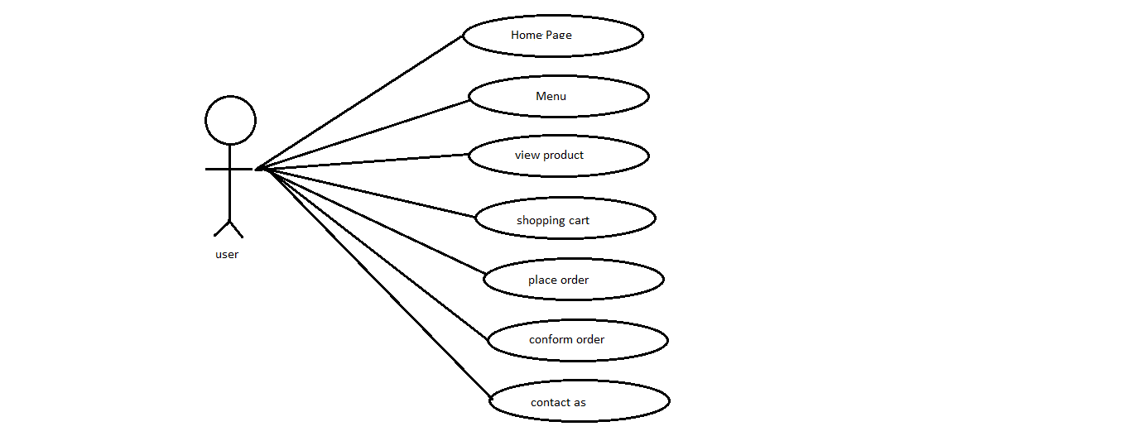
USER

Slide 18
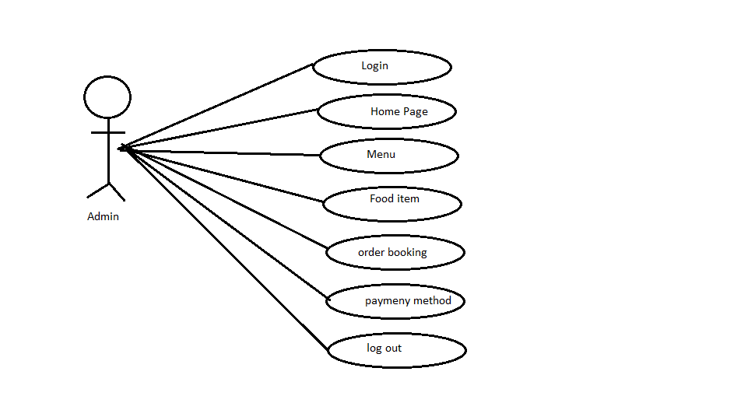
Admin

Slide 19
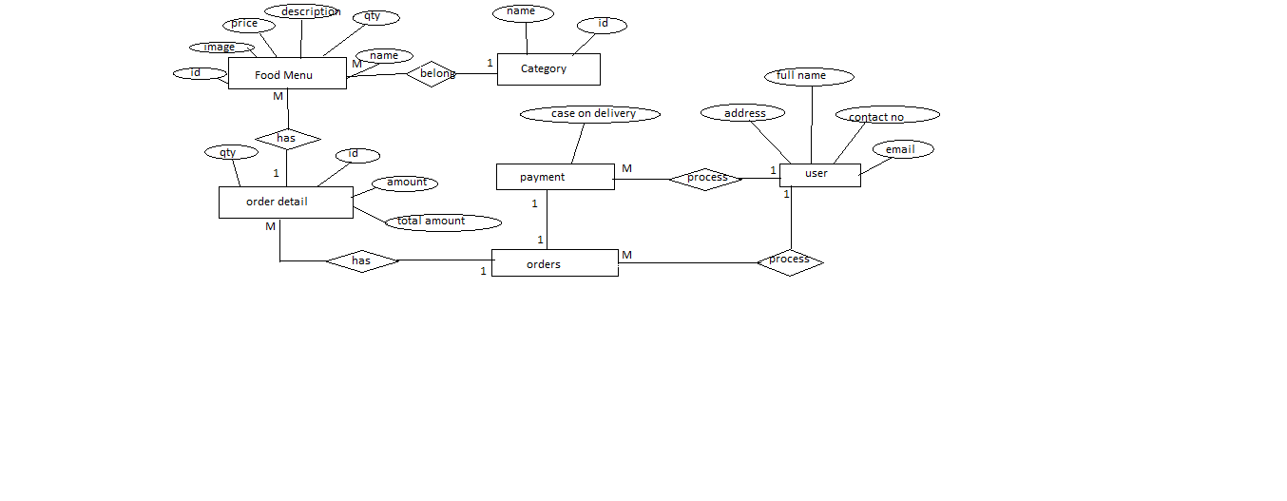
ER Diagram

Slide 20
Screen Layouts

Slide 21
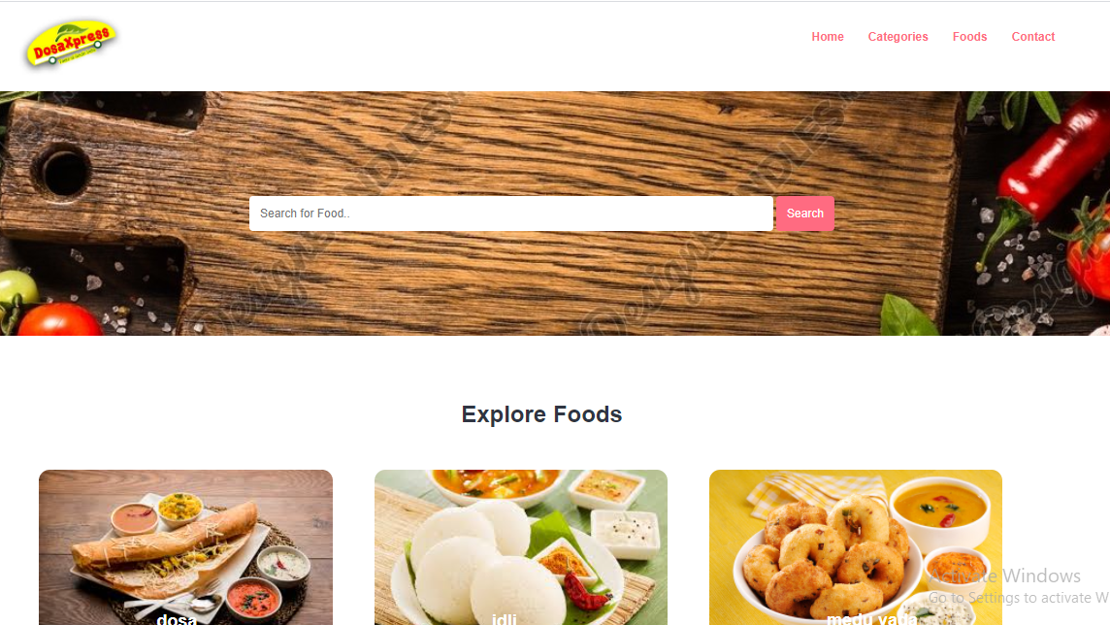
Home page

Slide 22
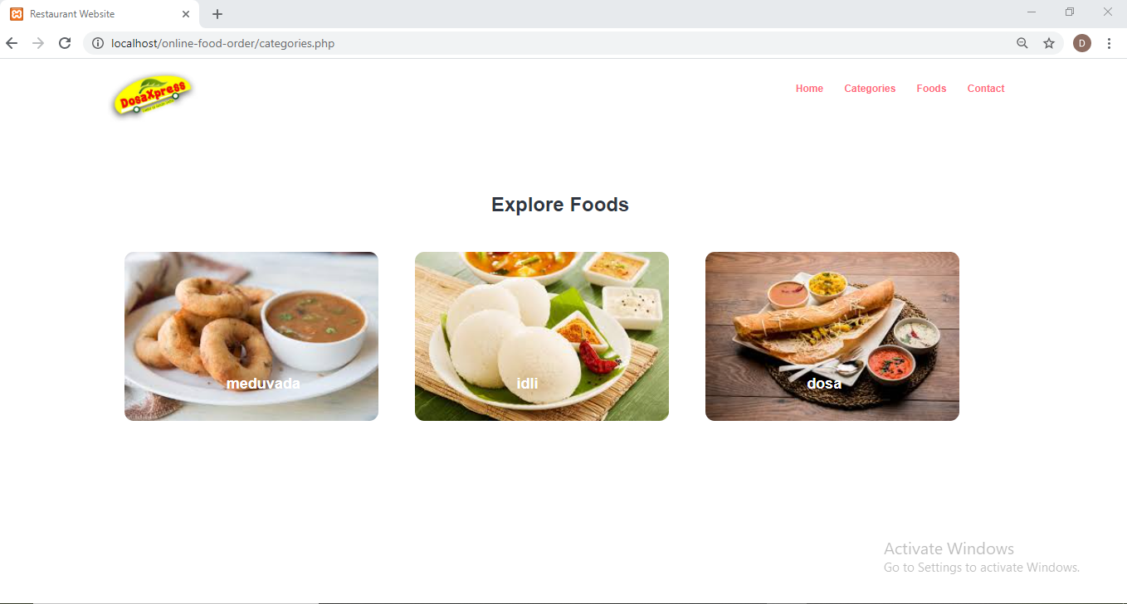

Slide 23
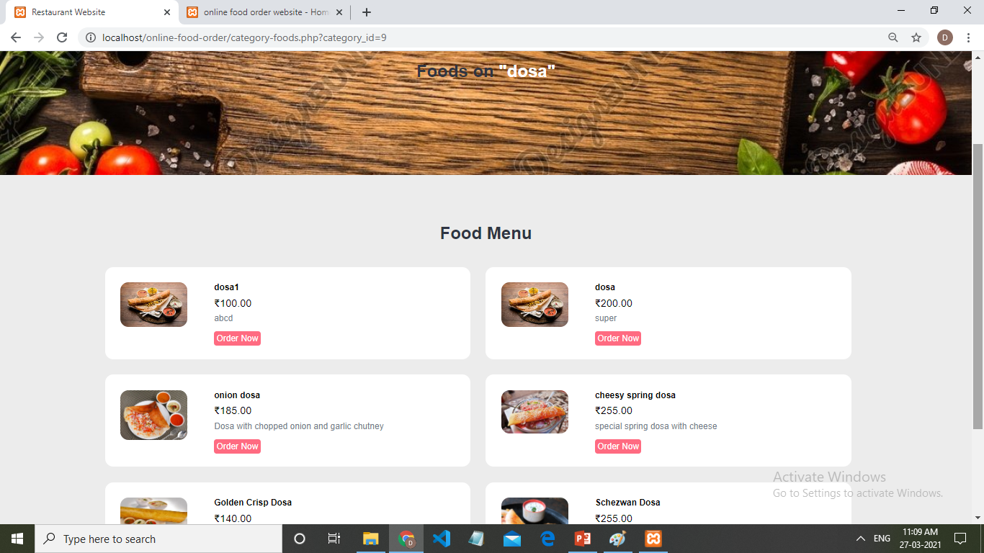

Slide 24
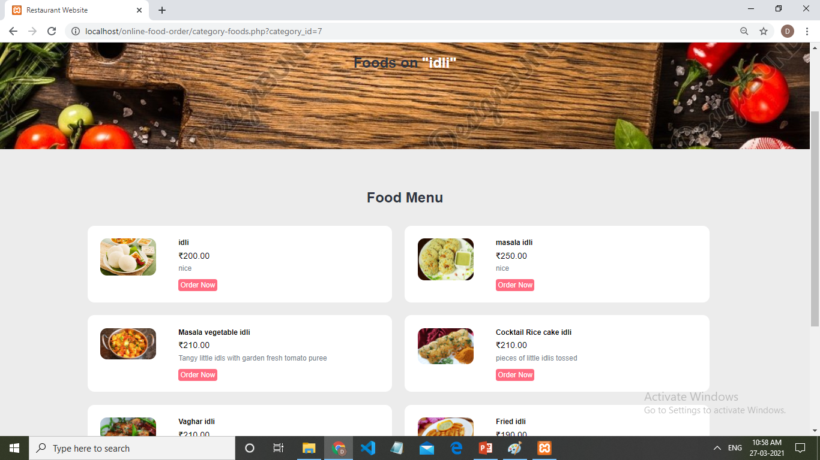

Slide 25
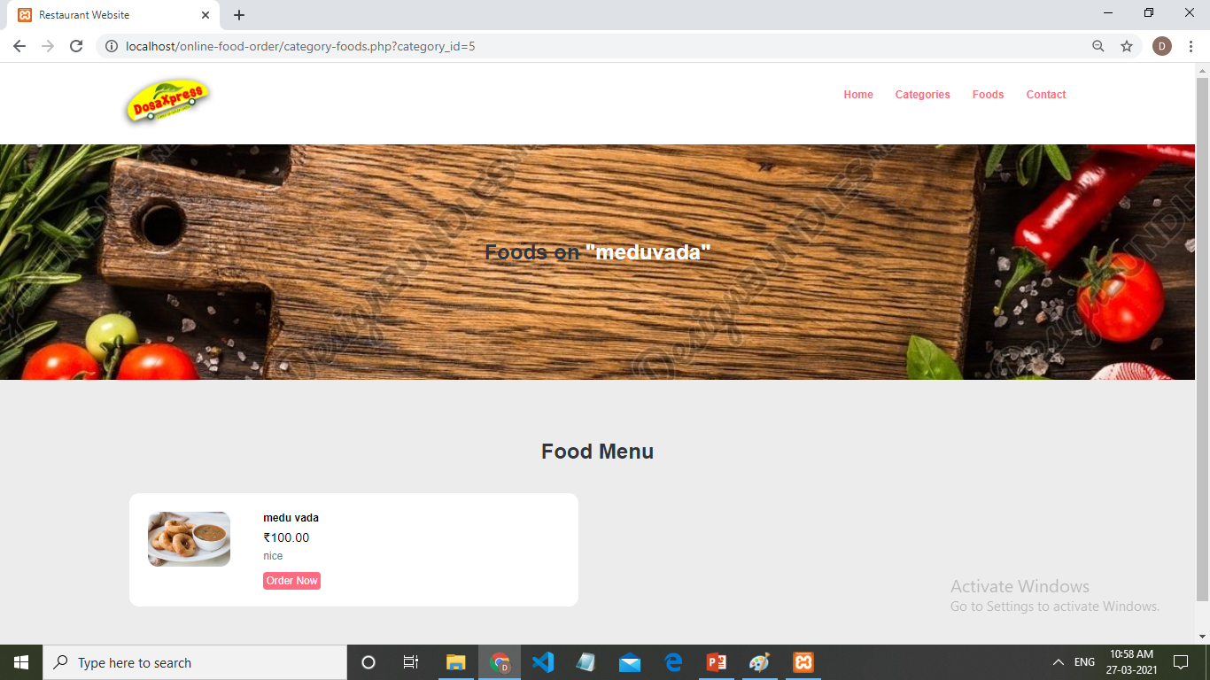

Slide 26
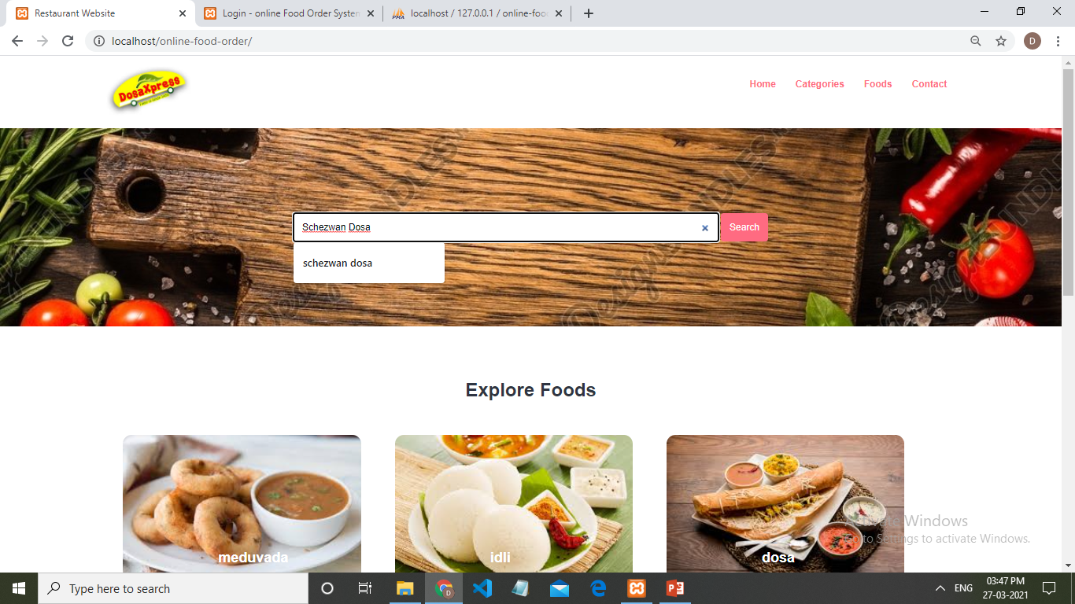

Slide 27
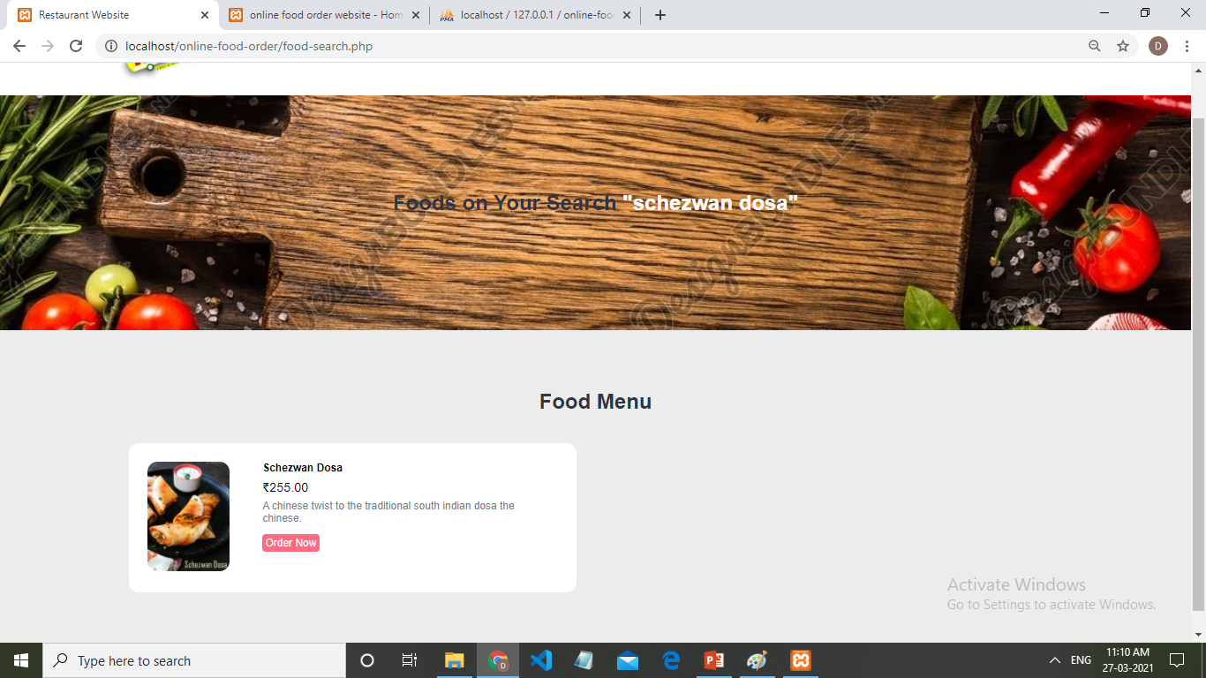

Slide 28
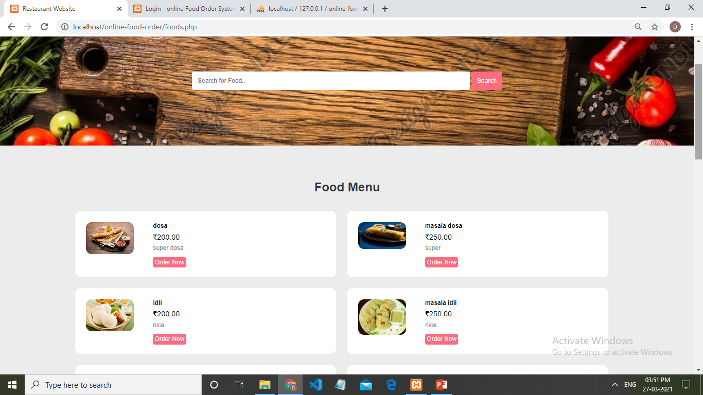

Slide 29
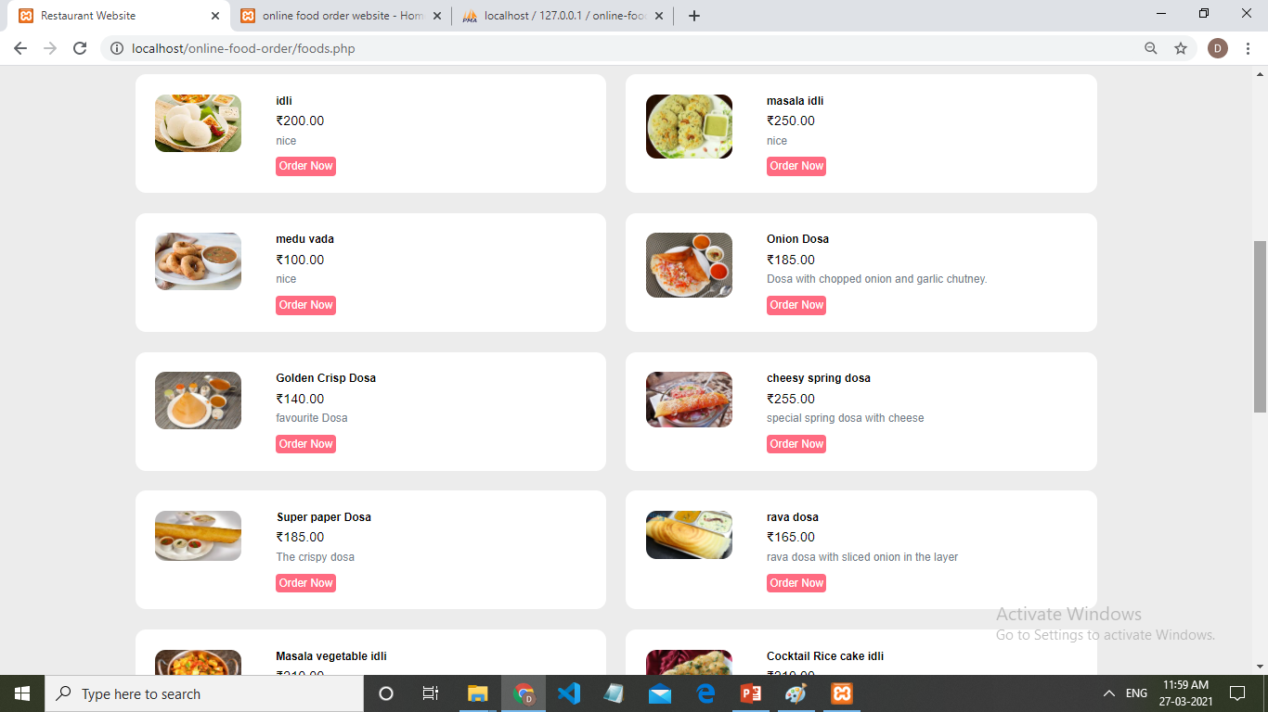

Slide 30
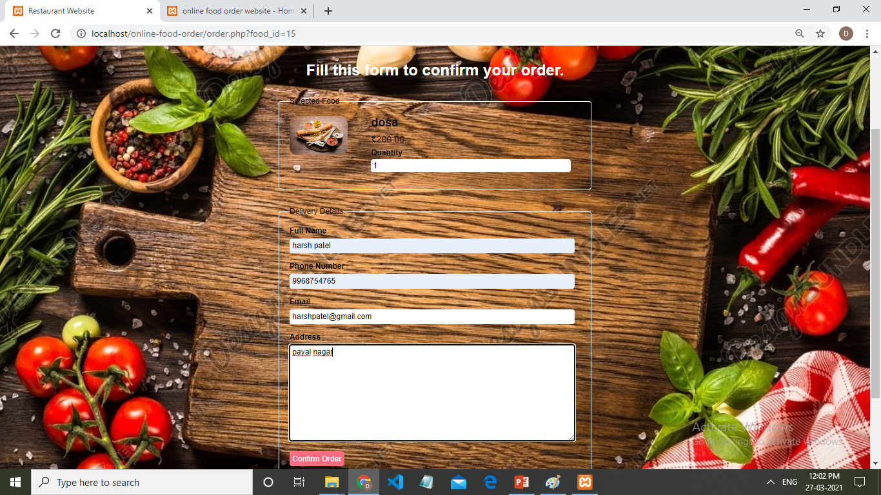

Slide 31
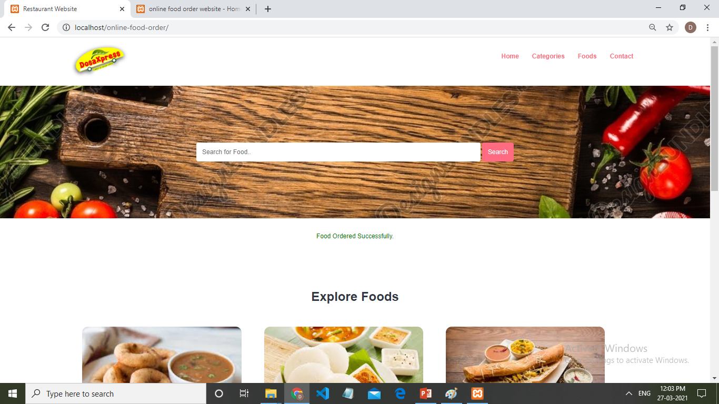

Slide 32
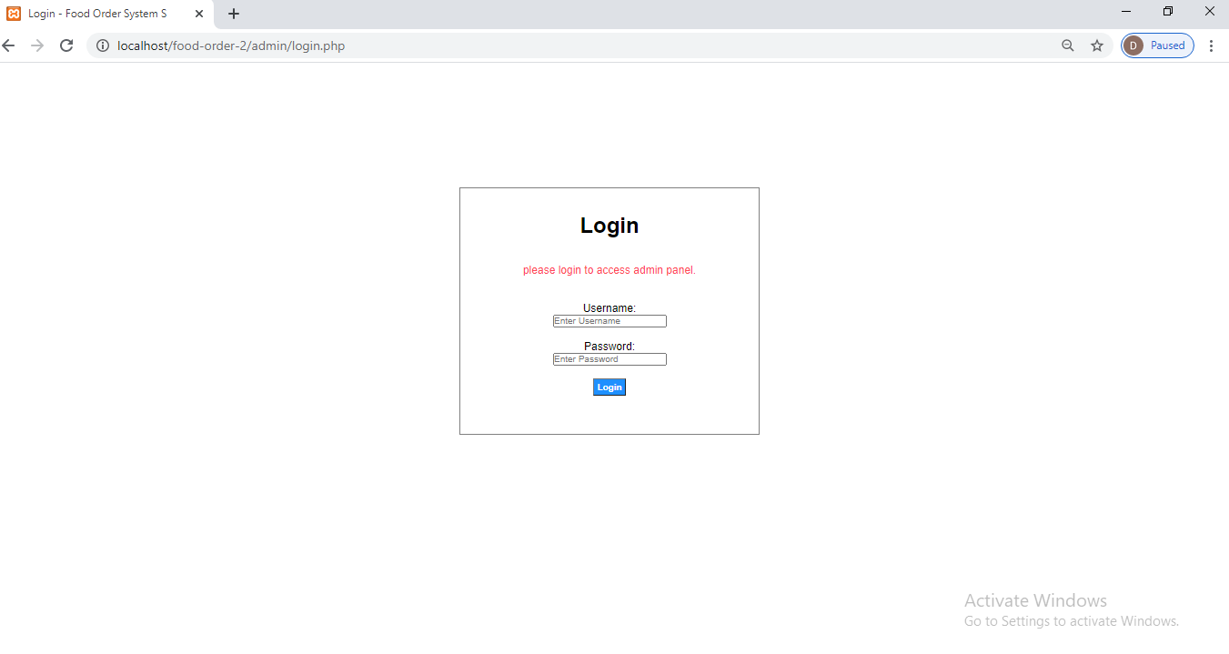

Slide 33
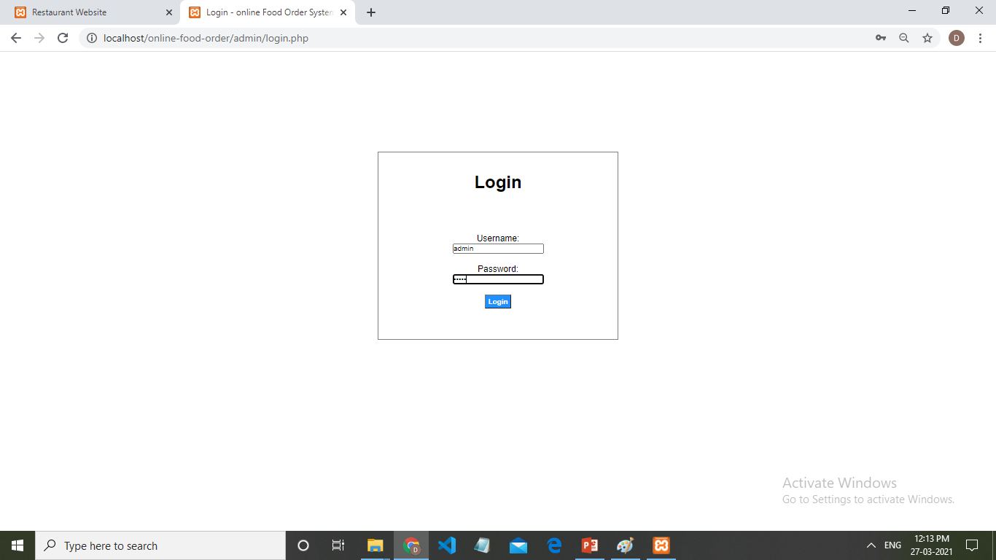

Slide 34
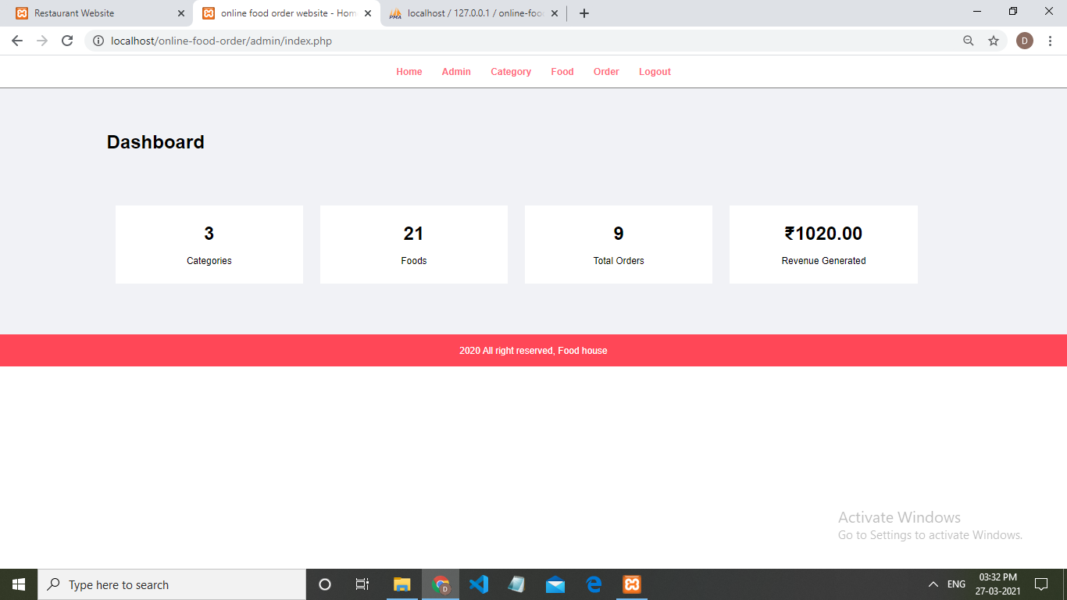

Slide 35
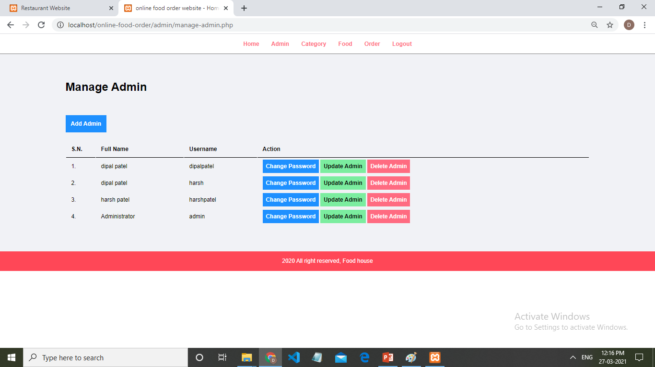

Slide 36
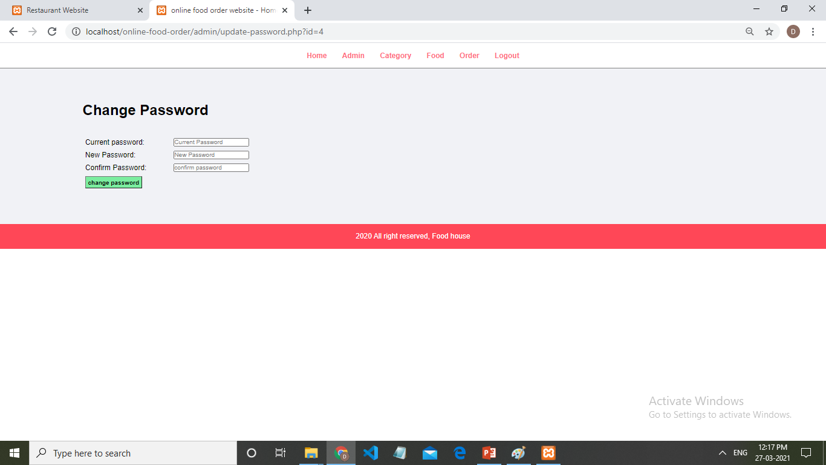

Slide 37
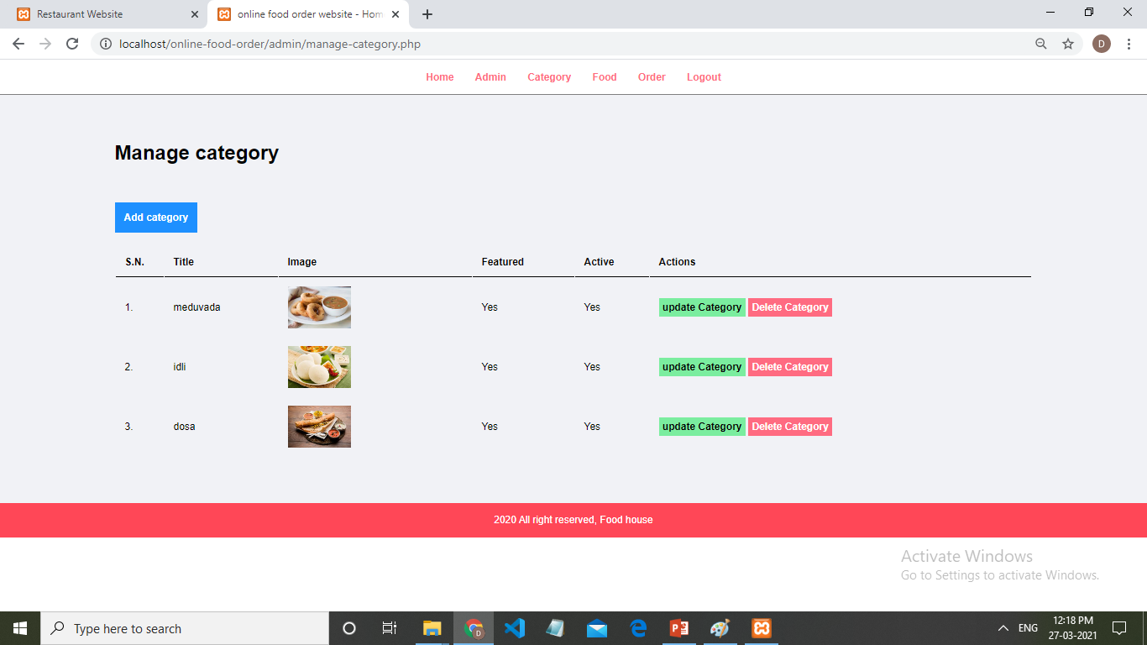

Slide 38
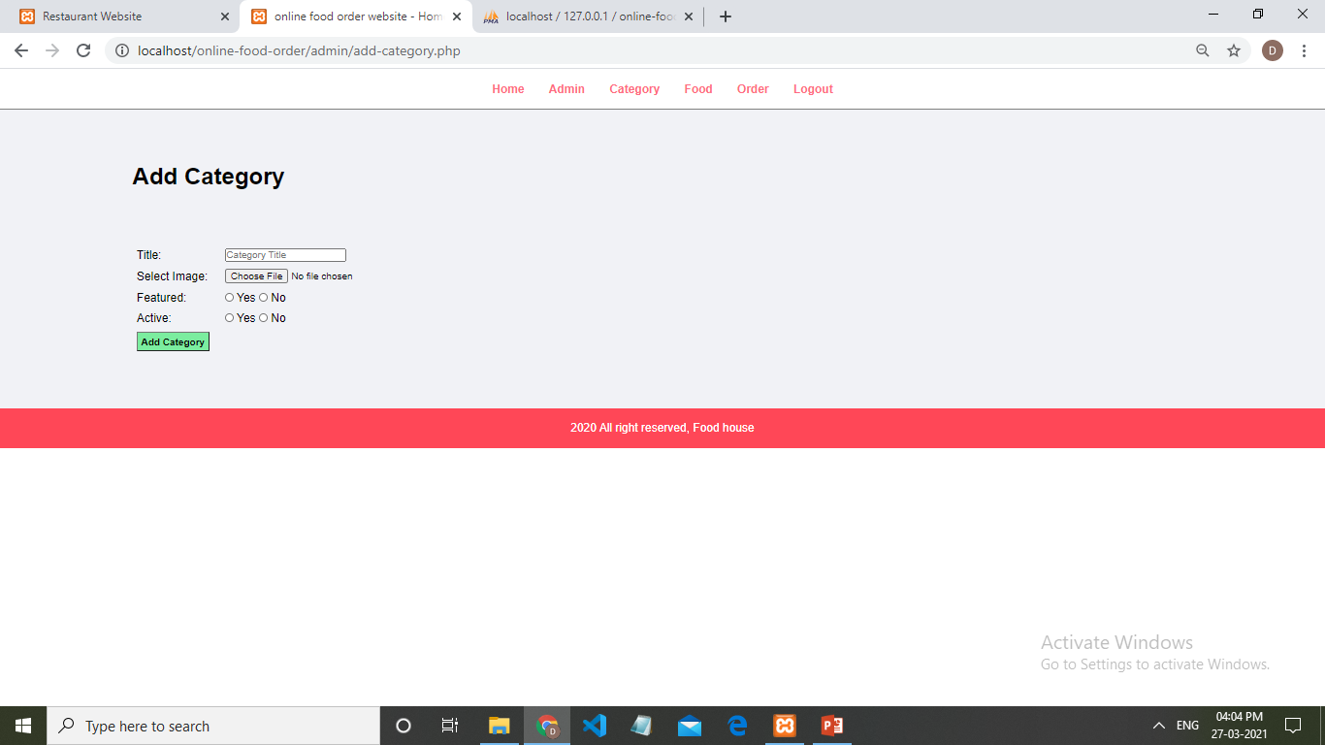

Slide 39
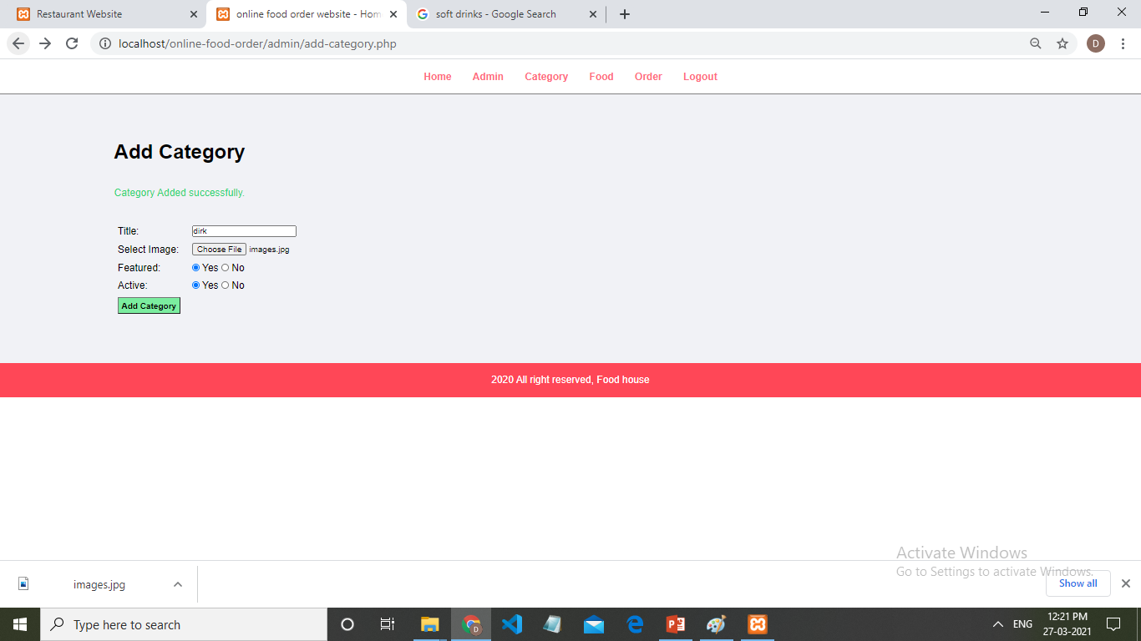

Slide 40
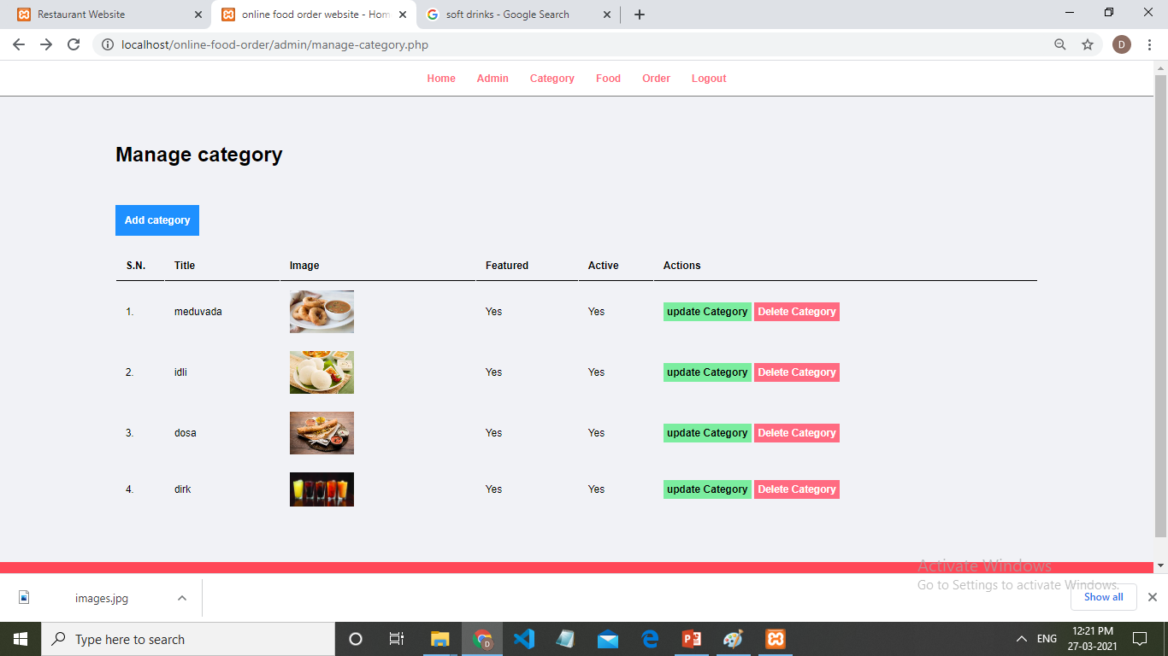

Slide 41
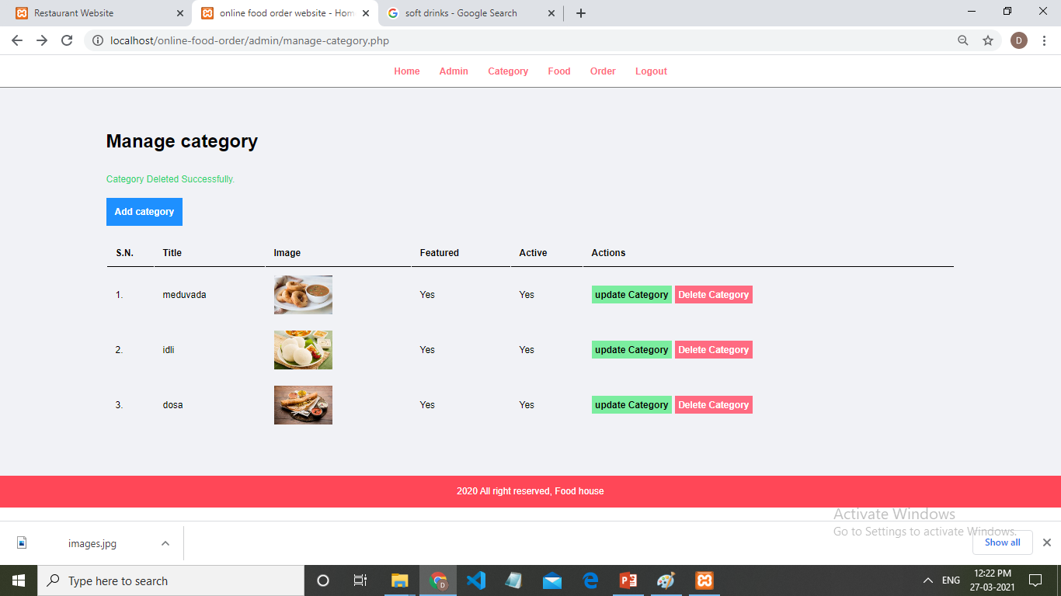

Slide 42
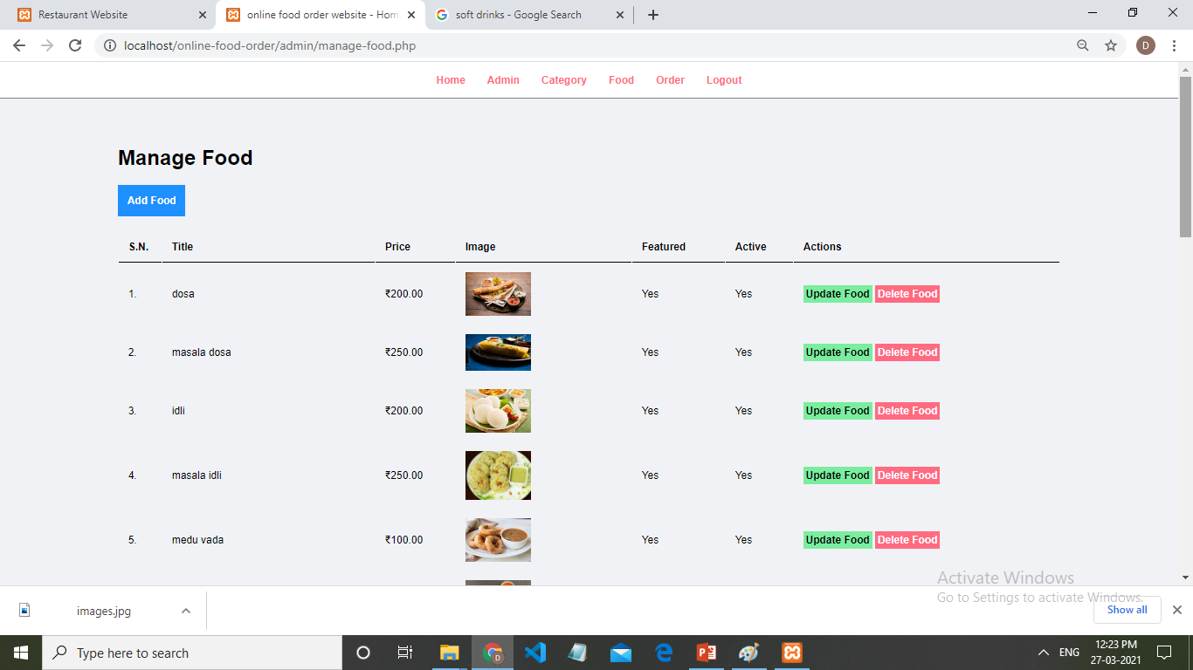

Slide 43
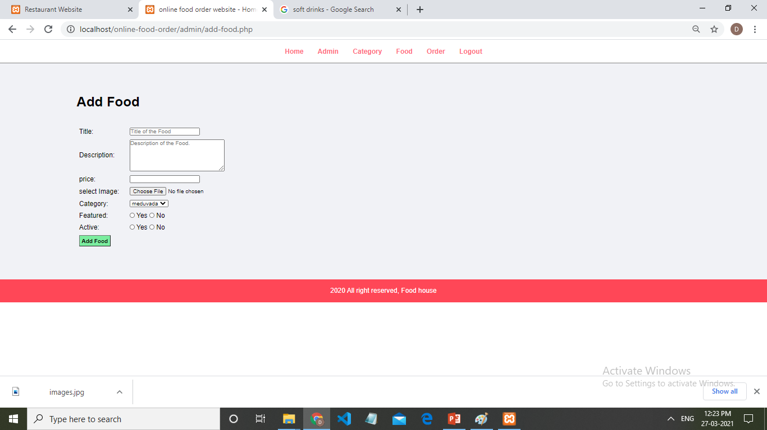

Slide 44
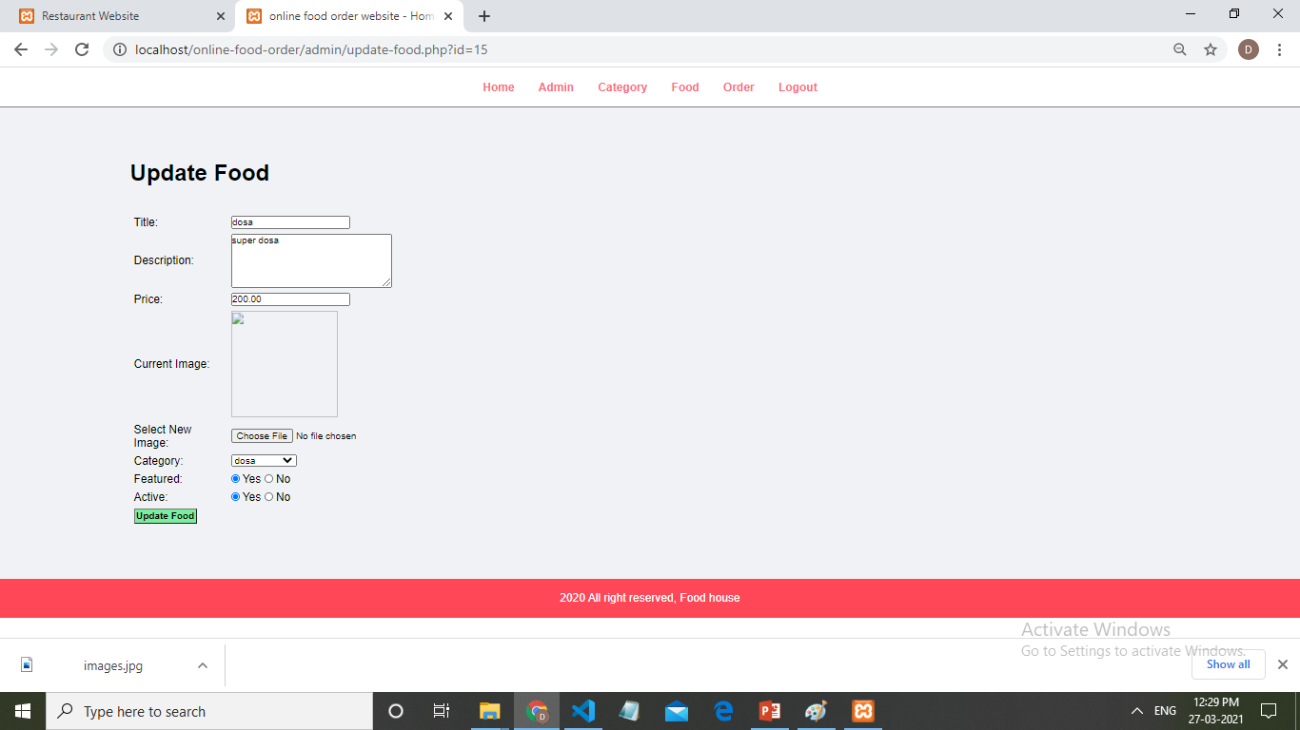

Slide 45
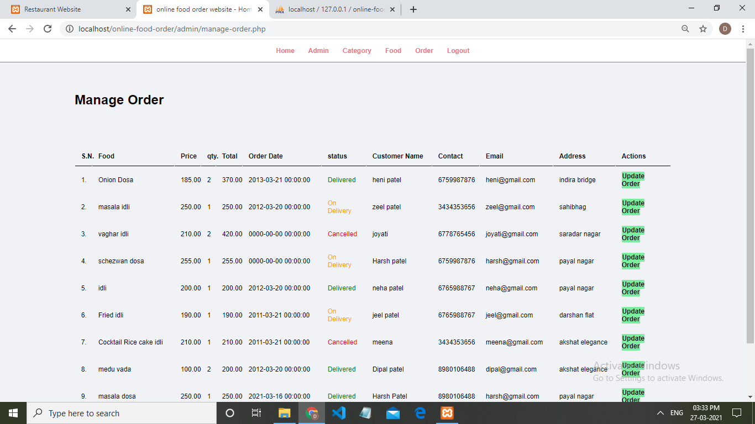

Slide 46
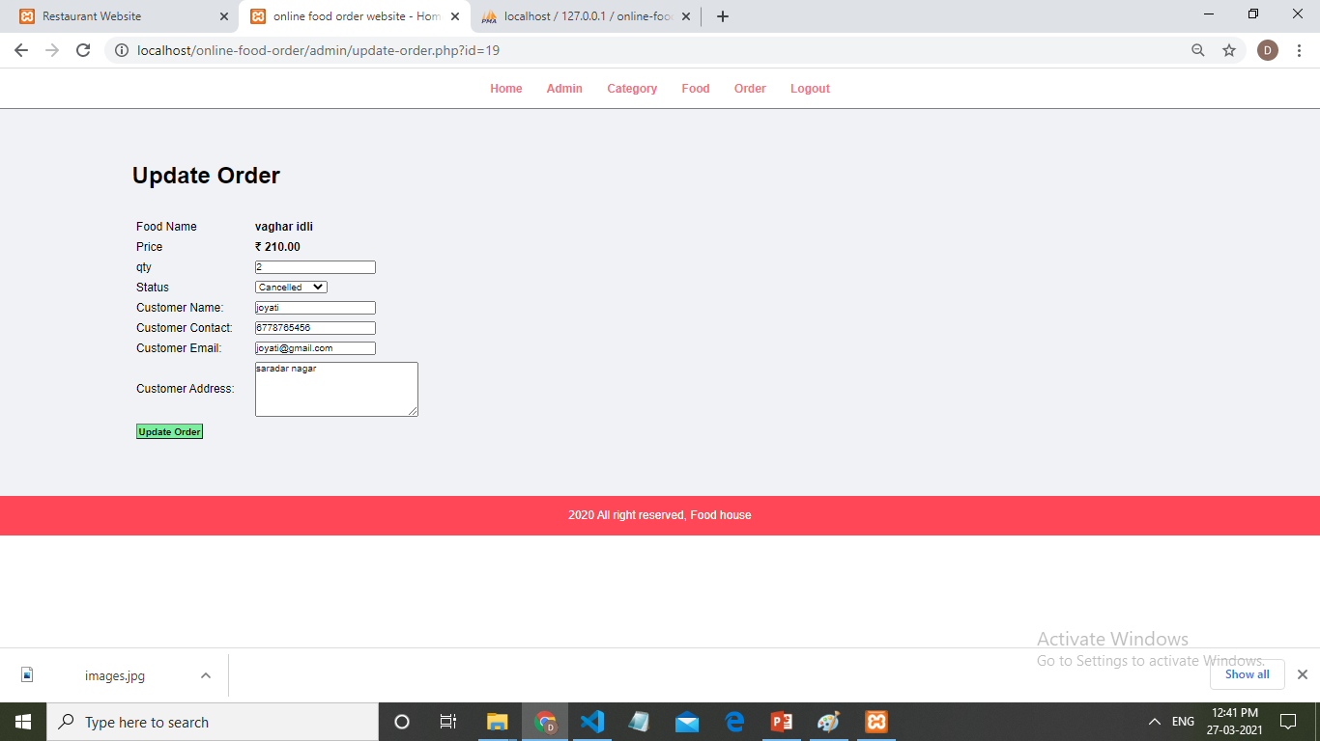

Slide 47
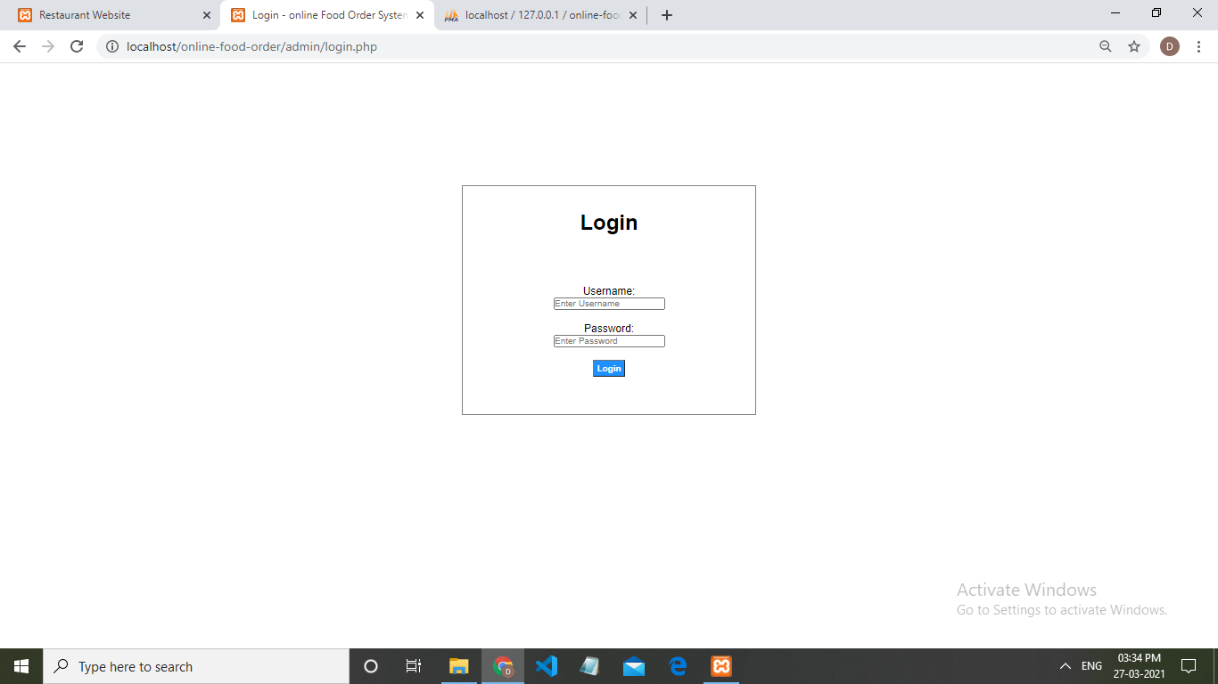

Slide 48

Since
2021
THANK YOU
Notes:
Links:
https://www.pexels.com/photo/alcohol-architecture-bar-beer-260922/

